Slide 1
Optimization Methods for Solving TSP
Team 6
Fu Rao Lin Xiaotao Su Qianhui
Yao Yang Zhang Ruijie Zhu Xinling
Notes:
Good evening, everyone. We are Team 6. Today we're excited to share our exploration into the optimization methods for solving traveling salesman problem.

Slide 2
1. Introduction to TSP
2. Heuristic Methods
Content
3. Exact Algorithms
4. DNN Method
5. Experiment & Conclusion
Notes:
Our presentation is divided into five parts, first we will introduce the TSP problem, then we will explain the optimization methods we used in this project, and finally we will show our experiment results and conclusion.

Slide 3
1
TSP Problem
Notes:
The first question. What is the traveling salesman problem?

Slide 4
Traveling Salesman Problem
Definition
Given a list of cities and the distances between each pair of cities, what is the shortest possible route that visits each city exactly once and returns to the origin city?
Objective
Minimize the total travel distance.
Notes:
Traveling salesman problem is a classic problem in optimization. The original problem involves a traveling salesman, who needs to visit all the cities once and then returns to the original position. (点) The salesman usually want to minimize the total travel distance to save time and fuel.

Slide 5

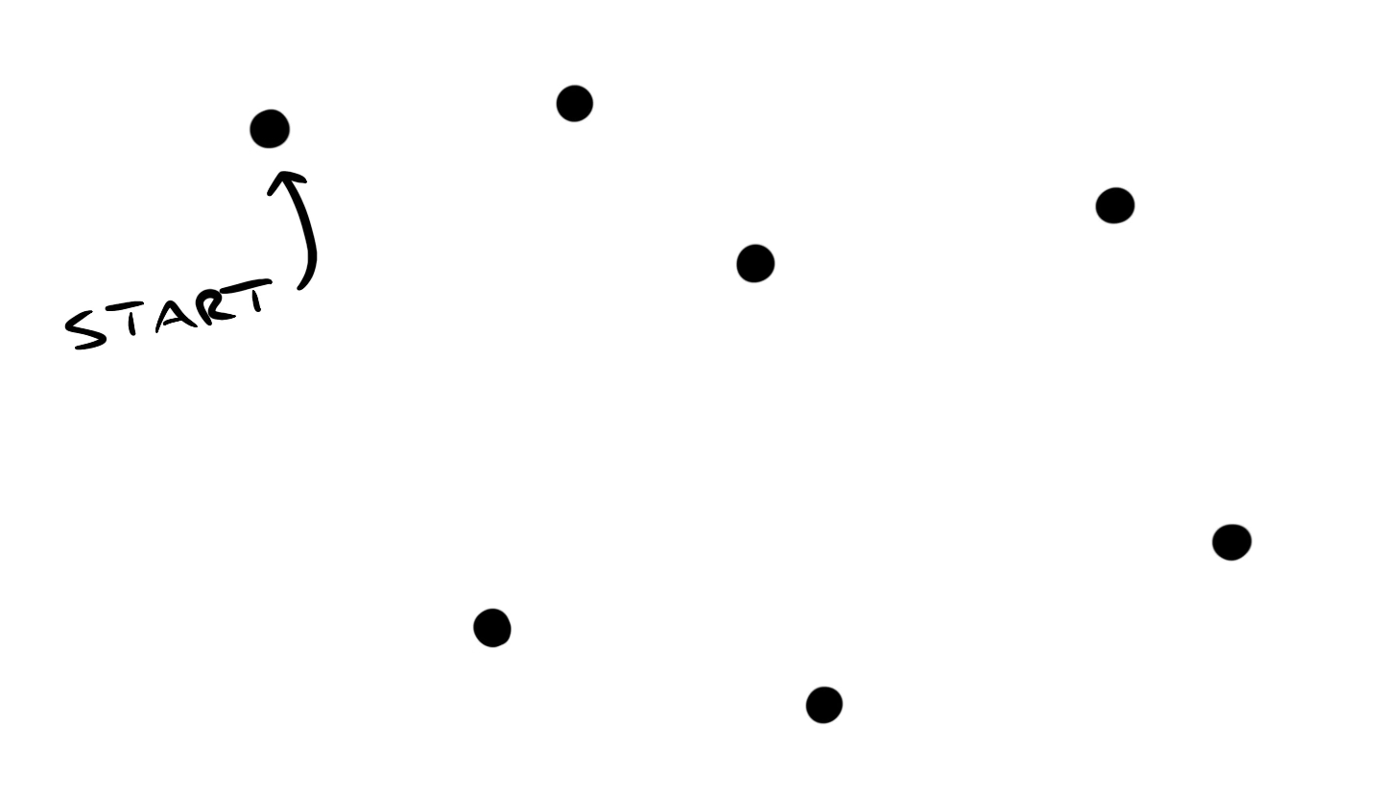
Traveling Salesman Problem
Notes:
The definition may be a bit abstract, so let's start with its practical application. Imagine that you are an expressman, you want to plan the shortest route to deliver today's packages. (点）You might start by marking all the destinations on a map, then attempt to figure out the shortest route. At first glance, this might not seem very difficult. You just visit the destination that is closest to you and that you haven't visited yet. (点完) That's not too bad. But what if your map looks like this?

Slide 6
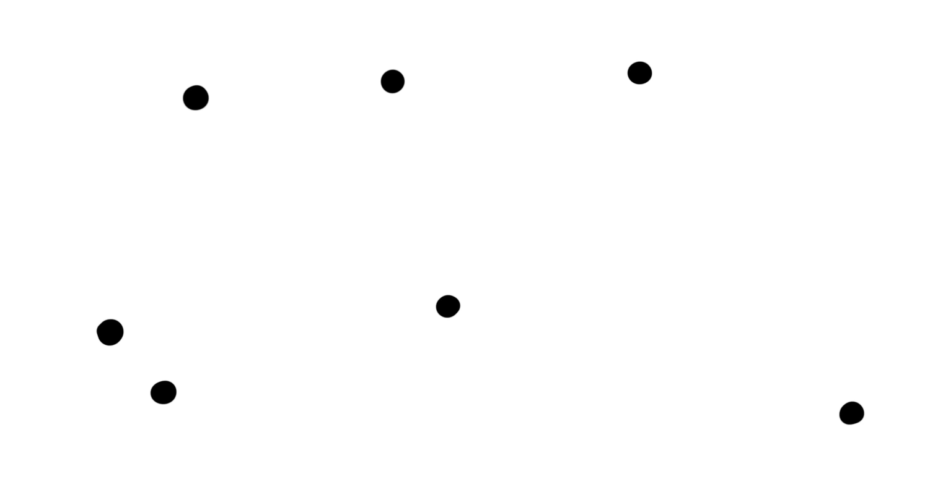
Traveling Salesman Problem
T O O L O N G !
Notes:
(点完）By going only to the closest destination, and never thinking ahead, you can get yourself caught in situations like this. It increases the total length of your trip.

Slide 7
Optimization Methods
Ant Colony Optimization
Genetic Algorithms
Simulated Annealing
Heuristic Methods
Exact Method
Dynamic Programming
Deep Neural Network
Pointer Networks
Notes:
So today, we are going to explore three different methods to helping find the shortest path for the expressman. We'll look at three heuristic methods, an exact method, and a deep neural network approach to see how they can effectively solve the traveling salesman problem.

Slide 8
Heuristic Methods
2
Notes:
Let’s start by the heuristic methods.

Slide 9
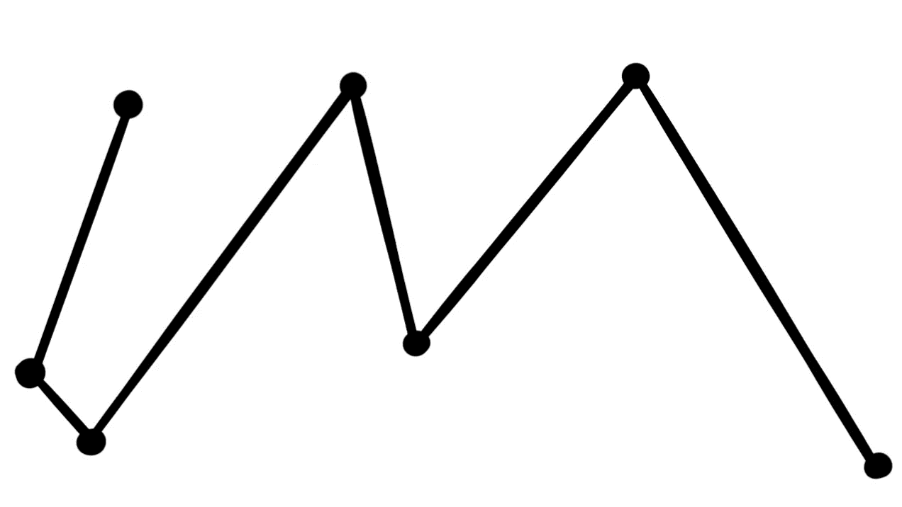
Traveling Salesman Problem
N P – h a r d
Notes:
(点)TSP is known to be an NP-hard problem, indicating that there is no algorithm can figure out all instances of the problem in polynomial time. It means that it will take a very long time to find the best solution as the problem gets bigger.

Slide 10

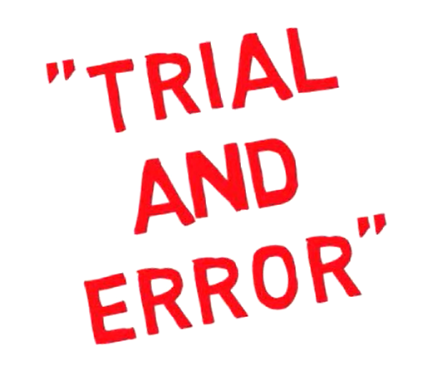

Heuristic Methods
Not the optimal solution
Good enough solution
Notes:
So, we introduce the heuristics methods, which can solve the large-scale TSP within a polynomial time. (点) A heuristic is a trial-and-error method of solving an optimization problem, which is based on intuition or experience. (点) Although the feasible solution it gives is not always the optimal one, it is particularly useful for finding a (点) good enough solution when facing a large-scale optimization problem.

Slide 11
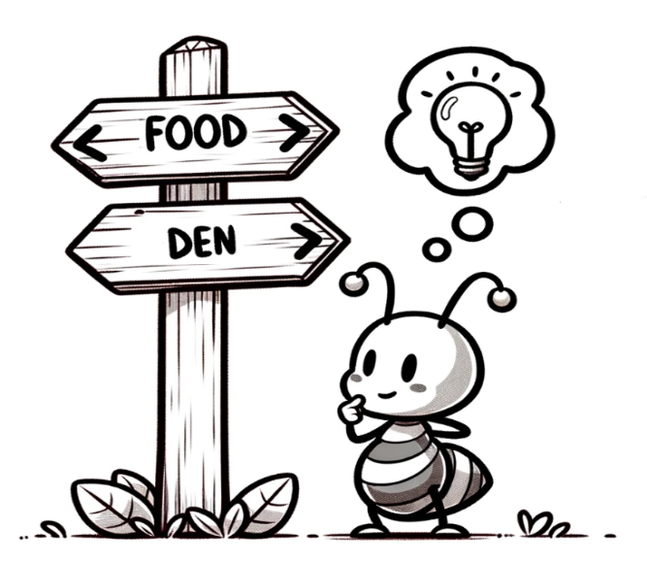

Ant Colony Optimization
Ant Colony Optimization Algorithm simulates the behavior of ant colonies in finding the best route while foraging for food.
Pheromones
As ants move, they release a trail of pheromones.
Notes:
The first heuristic method we used is Ant Colony Optimization Algorithm. This algorithm simulates the behavior of ant colonies in finding the best route while foraging for food. (点) As ants move, they release a trail of pheromones.

Slide 12

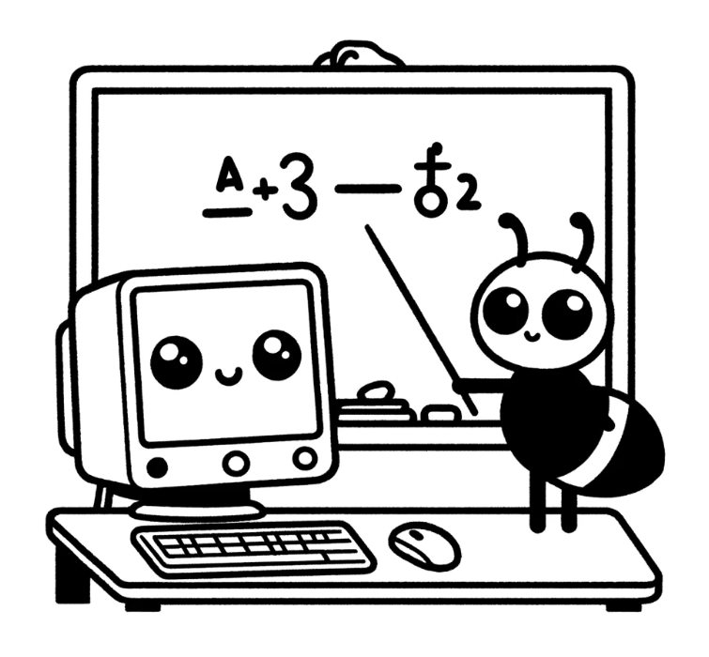
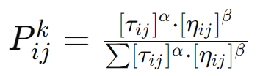
Ant Colony Optimization
Frequent walk to and from food source
Higher level of pheromones
Home
Food
Path selection based on the probability that influenced by pheromone levels, naturally favoring those with higher concentrations that indicate shorter routes.
Notes:
(点)An ant that has discovered a short and efficient route will walk to and from the food source more frequently than another that walks a longer route. So, there will be a stronger pheromone trail along the shorter route. (点) The rest of the colony will tend to choose the path with stronger pheromones without having to try each one. By adopting this algorithm in TSP, the computer can calculate the shortest route much quicker.

Slide 13
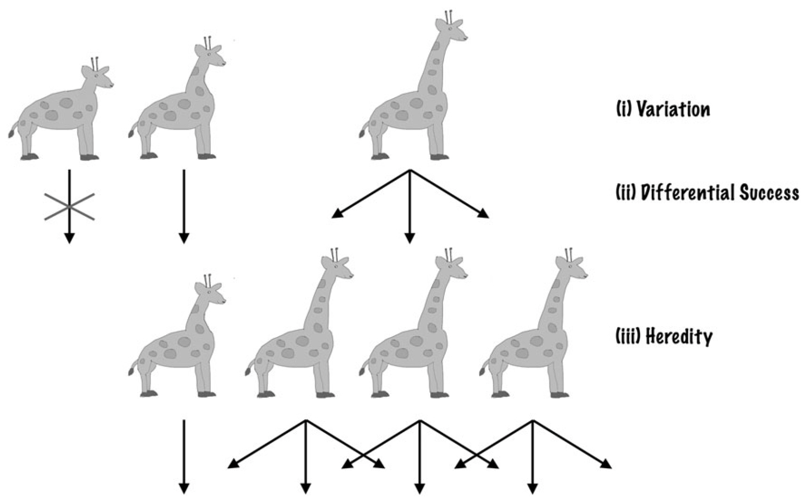
Darwinian theory of evolution
The principles of Darwinian evolution are summarized as follows:
Mutation
Inheritance
Selection
Notes:
Genetic algorithms are simplified versions of Darwinian evolutionary implementations that mimic nature. First, we need to know Darwinian theory of evolution.
Mutation: The characteristics (traits, attributes) of individual samples in a population may vary, which results in a certain degree of variation between samples.
Inheritance: Certain characteristics can be passed on to their offspring. As a result, the offspring and the parent samples have a certain degree of similarity.
Selection: Populations usually compete for resources in a given environment. Individuals who are better adapted to their environment have an advantage in terms of survival and therefore produce more offspring.

Slide 14
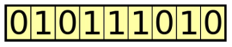
Genetic algorithm
Genetic algorithms preserve the set of candidate solutions (also known as individuals) for a given problem. These candidate solutions are iteratively evaluated and used to create the next generation of solutions.
Genotype
Population
Fitness function
Selection
Crossover
Mutation
Notes:
Genetic algorithms try to find the best solution to a given problem. Darwinian evolution preserves the individual traits of a population, while genetic algorithms preserve the set of candidate solutions (also known as individuals) for a given problem. These candidate solutions are iteratively evaluated and used to create the next generation of solutions. The better solution has a greater chance of being selected and passing on its characteristics to the next generation of candidate solution sets. In this way, with generational renewal, the set of candidate solutions can better solve the current problem.
There are six definitions.
Genotype
In nature, reproduction and mutation are represented by genotypes, which are collections of genes that make up chromosomes. In genetic algorithms, each individual is made up of chromosomes representing a collection of genes. For example, a chromosome can be represented as a binary string, where each bit represents a gene.
Population
Genetic algorithms keep a large number of individuals - a set of candidate solutions to the problem at hand. Since each individual is represented by chromosomes, individuals of these races can be thought of as collections of chromosomes.
Fitness function
In each iteration of the algorithm, individuals are evaluated using a fitness function (also known as an objective function). An objective function is a function used to optimize or to try to solve a problem.
Individuals with higher fitness scores represent better solutions, are more likely to be selected for breeding and their traits will be expressed in the next generation. With the progress of genetic algorithm, the quality of the solution will improve, and the fitness will increase. Once a solution with satisfactory fitness value is found, the genetic algorithm is terminated.
Selection
After calculating the fitness of each individual in the population, using a selection process to determine which individual in the population will be used to reproduce and produce the next generation, individuals with higher values are more likely to be selected and pass on their genetic material to the next generation.
There is still an opportunity to select individuals with low fitness values, but the probability is low. In this way, its genetic material is not completely discarded.

Slide 15
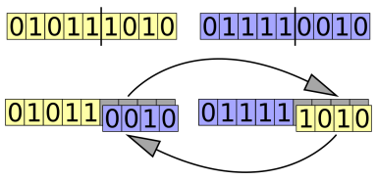
Genetic algorithm
Genetic algorithms preserve the set of candidate solutions (also known as individuals) for a given problem. These candidate solutions are iteratively evaluated and used to create the next generation of solutions.
Genotype
Population
Fitness function
Selection
Crossover
Mutation
Notes:
Crossover
To create a pair of new individuals, parts of the chromosomes of the parent sample selected from the current generation are usually swapped (crossed) to create two new chromosomes that represent the offspring. This operation is called crossing or regrouping.
Mutation
The purpose of mutation operations is to periodically randomly update populations, introduce new patterns into chromosomes, and encourage searching in unknown regions of the solution space. Mutations may appear as random changes in genes. It is achieved by randomly changing one or more chromosome values. For example, flip a bit in a binary string.

Slide 16
Genetic algorithm
Start
Create initial population
Calculate the fitness of each individual in the population
Mutation
Crossover
Selection
No
Select the individual with the highest fitness
Calculate the fitness of each individual in the population
Meet the termination conditions?
Yes
End
Notes:
This is the process of the genetic algorithms.
Create initial population
The initial population is a randomly selected set of valid candidate solutions (individuals). Because genetic algorithms use chromosomes to represent each individual, the initial population is actually a set of chromosomes.
Computational fitness
The value of the fitness function is calculated for each individual. For the initial population, this operation is performed once, and then again for each new generation after applying the genetic operators of selection, crossover, and mutation. Since the fitness of each individual is independent of the others, it can be calculated in parallel.
Since the selection phase following the fitness calculation usually considers individuals with higher fitness scores to be the better solution, genetic algorithm focus on finding the maximum fitness score. If it is a problem that requires a minimum value, the fitness calculation should invert the original value, for example, by multiplying it by the value (-1).
Selection, crossover and variation (As I mentioned before)
Applying the genetic operators of selection, crossover, and mutation to a population produces a new generation based on the better individuals in the current generation.
The selection operation is responsible for selecting the dominant individuals in the current population.
crossover (or recombination) operations create offspring from selected individuals. This is usually done by two selected individuals swapping parts of their chromosomes to create two new chromosomes that represent the offspring.
The mutation operation randomly changes one or more chromosomal values (genes) of each newly created individual. Mutations usually occur with a very low probability.
Algorithm termination condition There are two most common stopping conditions.
When determining whether an algorithm can be stopped, there may be a variety of conditions that can be checked. The two most common stopping conditions are:
Maximum number of generations has been reached. This is also used to limit the runtime and computing resources consumed by the algorithm.
There has been no significant improvement in individuals over the past few generations. This can be achieved by storing the best fitness values obtained for each generation and then comparing the current best value to the best value obtained several generations before. If the difference is less than a certain threshold, the algorithm can be stopped.

Slide 17

Simulated Annealing (SA)
Meta-heuristic algorithm
Inspired by the physical process of annealing in metallurgy
Heat and then slowly cool a material to alter its physical properties - reducing defects and increasing strength.

Slide 18
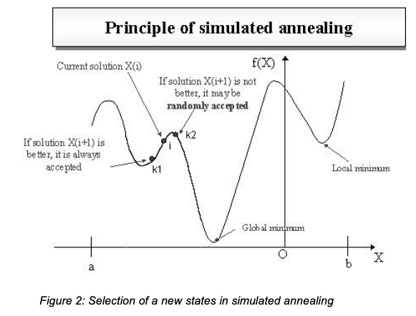
How does SA work?
Used in computing to find an approximate solution
Starts from a random solution
Make incremental changes
Improve the solution, accepted
Decrease the solution, accepted with a certain probability (decreases over time) - avoid getting stuck

Slide 19
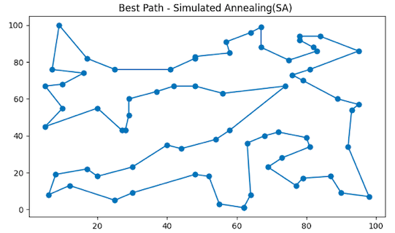
Simulated Annealing for TSP
Start with a random route to visit all the cities
Make small changes
Decide if the new route is better
Repeat

Slide 20
Exact Algorithms
3

Slide 21
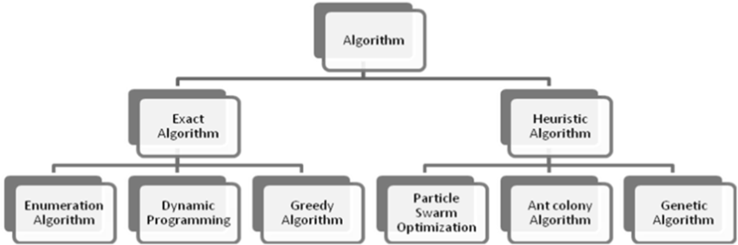
Exact Algorithm
Guarantee finding the perfect, optimal solution
Systematically checking all possible options
Very precise, but computationally intensive

Slide 22
Dynamic Programming (DP)
What is Dynamic Programming?
A subclass of Exact Algorithms
Useful for problems that can be broken down into overlapping subproblems
Solved just once and stored
Efficient - build up the solution to a problem from the solutions of its smaller subproblems.

Slide 23
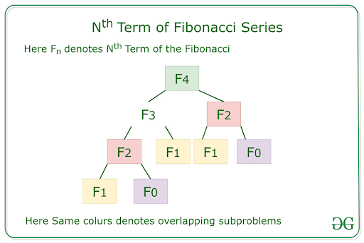
DP Example - Fibonacci
Fibonacci Sequence
a series of numbers where each number is the sum of the two preceding ones
starting with 0 and 1.
the sequence goes 0, 1, 1, 2, 3, 5, 8, 13, and so on
Define the base cases: Fibonacci(0) = 0 and Fibonacci(1) = 1.
To compute Fibonacci(4), we need Fibonacci(3) and Fibonacci(2).
To find Fibonacci(3), calculate Fibonacci(2) and Fibonacci(1).
Fibonacci(2) is found by calculating Fibonacci(1) and Fibonacci(0)
Store the results of Fibonacci(2) and Fibonacci(3) to avoid unnecessary recalculations

Slide 24
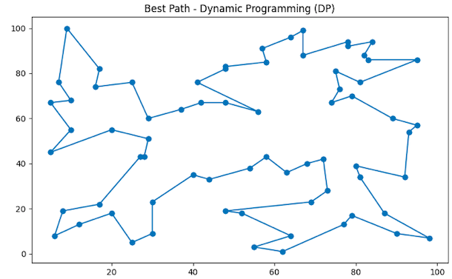
Dynamic Programming for TSP
Solve for fewer cities and keep track of the best routes.
Once you have the best routes for smaller groups, use them to figure out the best routes when you add more cities.
Keep adding cities and using the best from before to find new best routes.
Use all the information you’ve gathered to find the shortest route

Slide 25
4
DNN Method
Method base on neural network

Slide 26
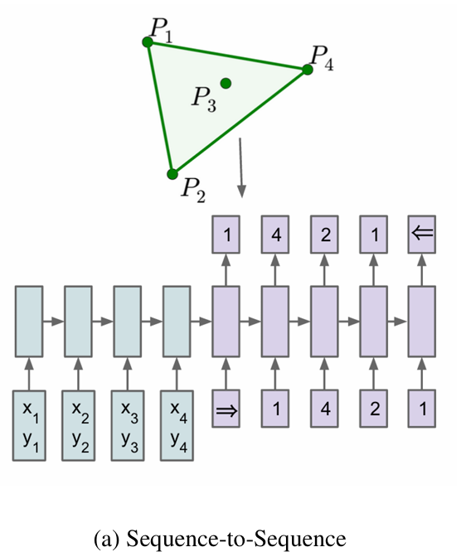




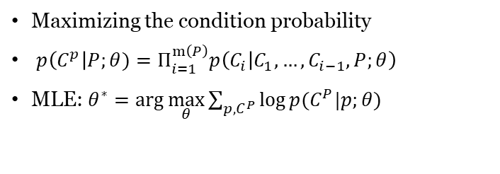
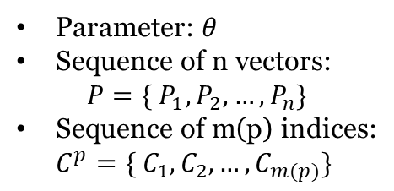
Pointer network
Background
Seq-to-seq (LSTM)
Parameter: $θ$
Sequence of n vectors:
$$P=\{ P_{1}, P_{2},…,P_{n}\}$$
Sequence of m(p) indices:
$$C^{p}=\{ C_{1}, C_{2},…,C_{m(p)}\}$$
For machine translation
Encoding of inputs
Output using autoregression
Training for seq2seq
Maximizing the condition probability
$p\left(C^{p}\right|P;θ)=Π_{i=1}^{m\left(P\right)}p\left(C_{i} | C_{1},…,C_{i−1},P;θ\right)$
MLE: $θ^{∗}=\arg{\max_{θ}{\sum_{p,C^{P}}{\log{p(C^{P}|p;θ)}}}}$
Problem for solving TSP
The selection of single outputs is fixed
Machine translation: words inside the dictionary
TSP: According to the input length
Notes:
Now I will introduce another method for finding the optimize solution for TSP, which is neural base method. Here we use pointer network. This kind of network is based on seq-to-seq model, the idea of it is to firstly encode the input, and then generate the output by autoregression method. And autoregression means that the last output token generated by model will be the next input of the model. The target of the seq-to-seq model is to maximize the condition probability. For example, for an input P that is already known and a previous output C that is already known, we want to maximize the likelihood of the correct output at the moment.
However, it can only solve the problem which the selection of single outputs is fixed. For example, for translation task, the output of the word will be limited to the word in dictionary. The problem such as TSP have different output options according to the input length, which is the location number, it could be 20 TSP problem, which is 20 location output options for each time, and for 40 TSP problem, it needs to output one of 40 locations.

Slide 27
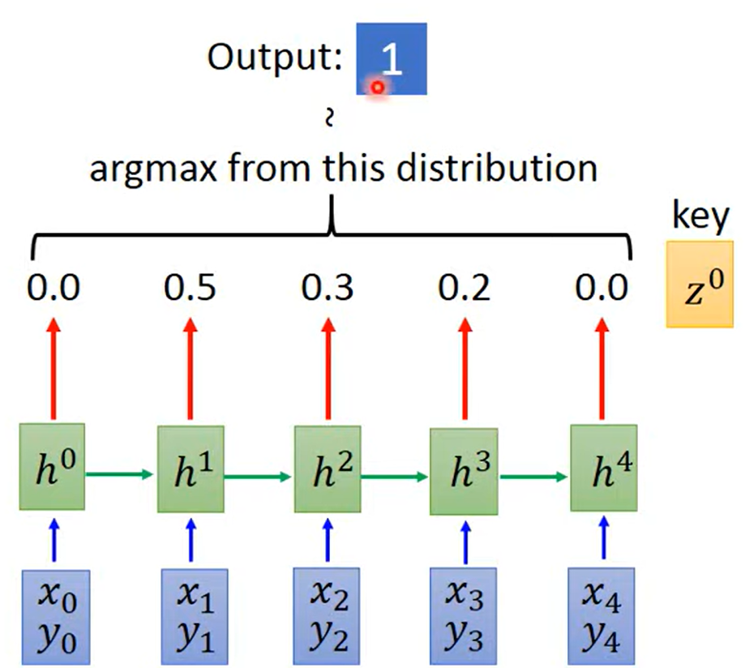
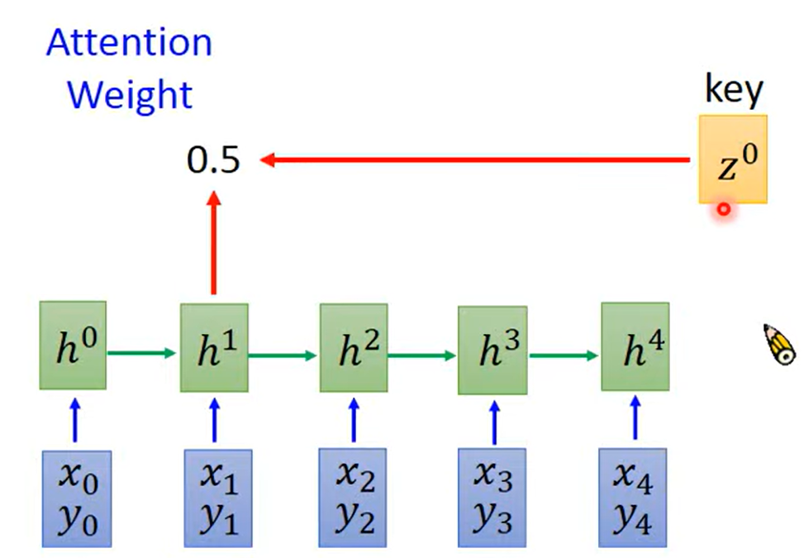
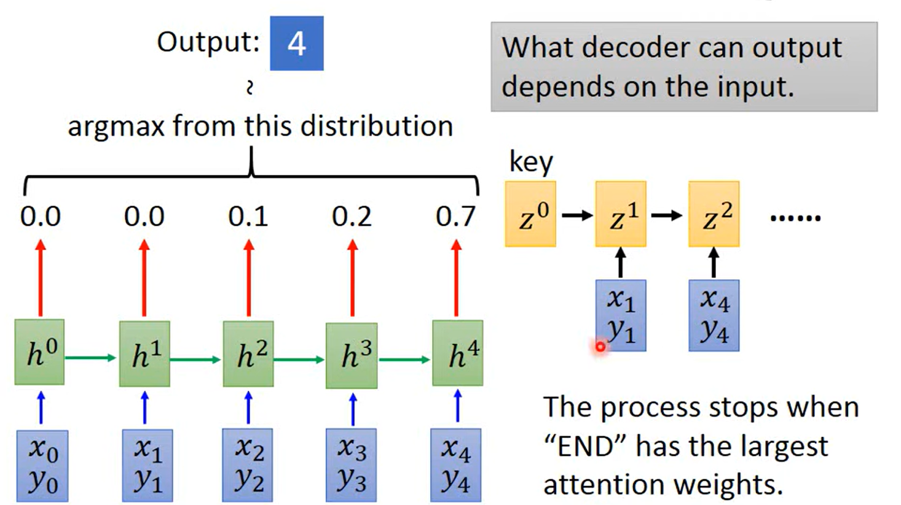
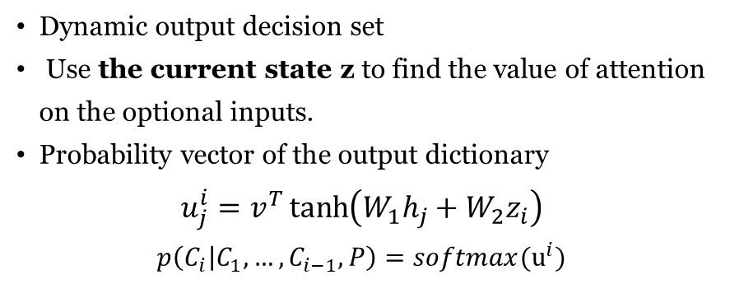
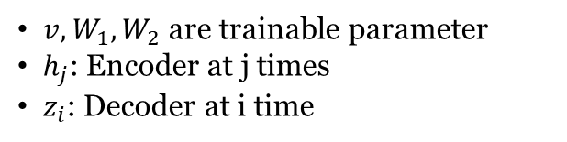
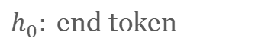
Pointer network
Attention
$h_{0}:$end token
Dynamic output decision set
Use the current state z to find the value of attention on the optional inputs.
Probability vector of the output dictionary
$$u_{j}^{i}=v^{T}\tanh\left(W_{1}h_{j}+W_{2}z_{i}\right)$$
$$p\left(C_{i} | C_{1},…,C_{i−1},P\right)=softmax(u^{i})$$
$v,W_{1},W_{2}$ are trainable parameter
$h_{j}$: Encoder at j times
$z_{i}$: Decoder at i time
Process
Use Long Short Term Memory(LSTM) as seq-to-seq
Output word by word in sequence
The output of the previous decoder is used as next input
Supports inputs of different lengths
Notes:
Pointer network using attention to fix this problem. It uses the current state z_i and then combine with each original input h_j to generate the weight u_ij, we can consider each weight means how much attention should we take for each word, and this serves as an important indicator of the model's choice of outputs.
Finally, the model will select the output token with highest weight.
After the model has output the first word, the next output word will not only refer to the current state information but also use the information from the previous input as a reference, and it will stop once the output is stop token h0.
In summary, it uses LSTM as sequence model, which is a model with a long term memory and short term memory. This kind of model can make better understating for the information in sentences and it is a sequence to sequence model, Back to the pointer network, firstly the model encode the input word one by one, generate the latent vector for the whole sentence and for each input word. Then, for decode part, the latent vector is used to interact with the latent vector for input word and generate weight. The model will select the highest weight word and combine it with the current z vector to update the next z vector, until it output stop token. It makes the input can be vary according to the input size.

Slide 28
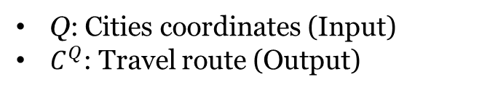
Reinforcement Learning based on Policy Gradient
（Inference in TSP）
Notation
Q: Cities coordinates (Input)
$C^{Q}$: Travel route (Output)
Explanation
Objective: Route Length
Baseline function
Provide by Actor-Critic
Real length
Notes:
For the training part, we randomly generated the 70 cities and used the reinforcement learning to train the model. The formulas are shown here. We use the expectation the route length of once travel as the reward. Then we use policy gradient method to reduce the gradient variance.

Slide 29
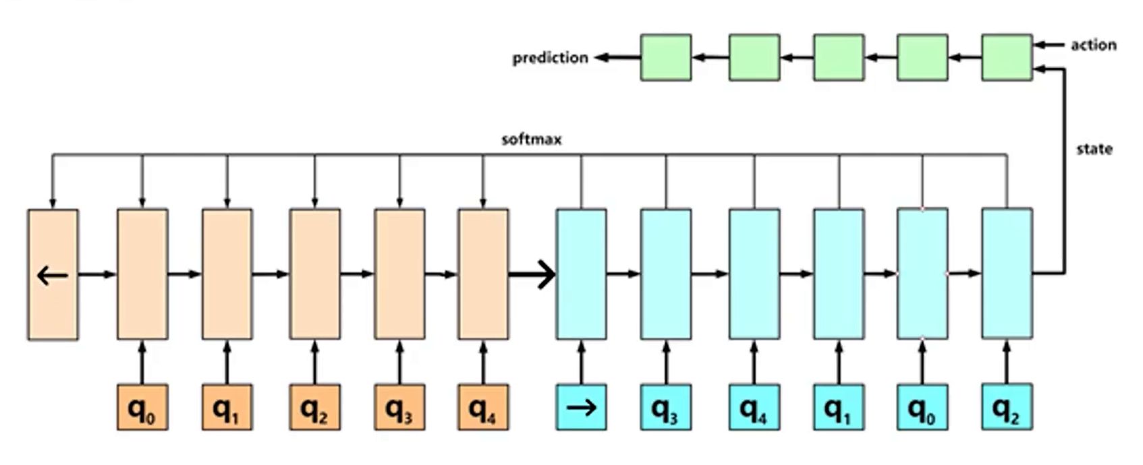
b(Q): Actor-Critic
Critic: LSTM
Given Q, predict the reward value based on the Actor’s final state
Actor: PN
Policy network that generates actions after accepting state
Objective
Min the square error of predicted and true label
Stochastic Gradient Descent
Notes:
Here we use Actor-Critic model. After we generate the ouput, we will use the Critic (here we use another LSTM), takes the mean square error of the predicted and actual reward values as the objective and is trained with SGD method. The Critic provides the feedback b(Q) based on the latest state of our pointer network.
The strong advantage of Pointer Network is that once training is completed, the number of cities can be changed, and the model can still perform well without retraining during testing.

Slide 30
Limitations and Approvements
Liquorice chupa chups applicake apple pie cupcake brownie bear claw cake gingerbread cotton candy. Bear claw croissant apple pie. Croissant cake tart liquorice tart pastry. Gingerbread jelly soufflé bonbon sesame snaps.
Treats the input as a sequence
The order of the nodes in a TSP instance is meaningless
Trained by supervised learning
Solutions used as labels might be difficult to obtain
Supervised Learning
⬇️
Reinforcement Learning
Recurrent Neural Network
⬇️
Embedding Layer
Notes:
Then I would like to talk about the limitations of the original pointer network and briefly share some improved approches.
From the previous section, we know that the original pointer network is trained by supervised learning with precomputed near-optimal TSP solutions as labels. This could be a limiting factor, since in real-world applications such solutions might be difficult to obtain. To overcome the above limitation, the pointer network with reinforcement learning was proposed, which uses the tour length of the partial TSP solution as the reward signal.
Another limitation of the original pointer network is that, it treats the input as a sequence, while many TSP problems have no natural internal ordering. For example, the order of the nodes in a TSP instance is actually meaningless; instead, it should be better viewed as a set of nodes. To address this issue, researchers replaced the recurrent neural network in the encoder of the original pointer network with a simple embedding layer that was invariant to the input sequence.

Slide 31
Experiments
&
Conclusion
5
Notes:
In the last section, I would like to analyse our experiments results and summarize our research.

Slide 32
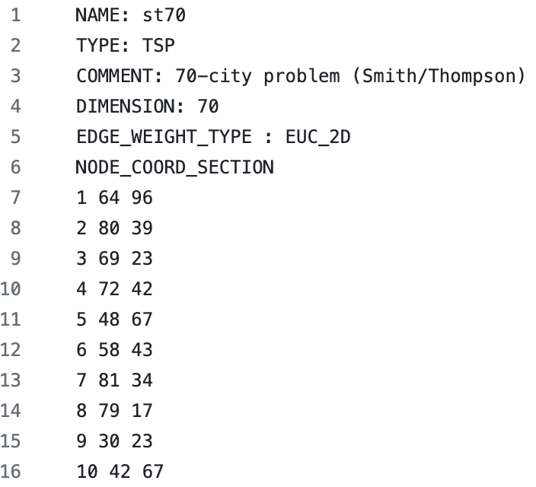
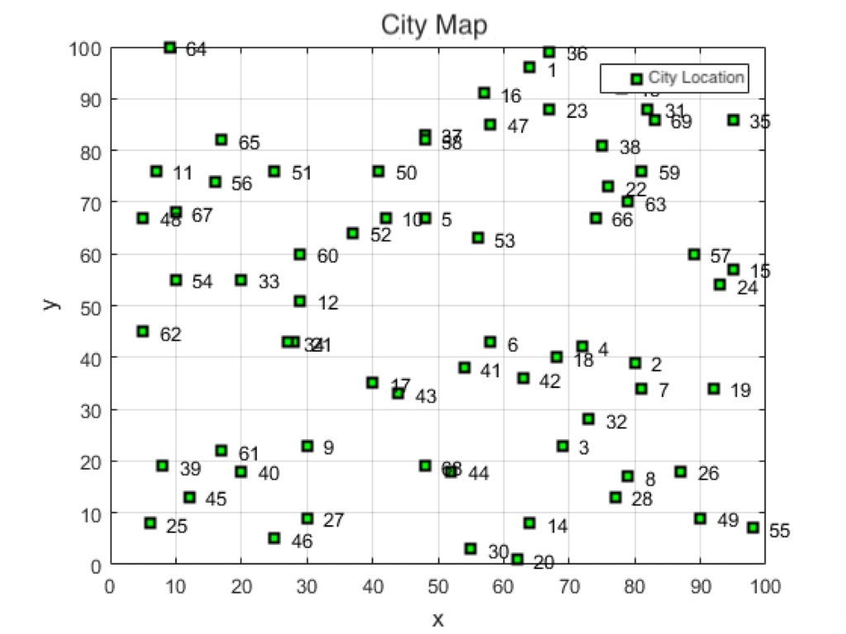
Datasets
Notes:
Oriented to solve the TSP problem, we delved into three classes of algorithms and selected representative methods from each class to conduct experiments. We used st70 as the dataset, which contains the serial numbers and coordinates of 70 cities. Then we wrote code to implement different methods to generate the corresponding roadmap and the length of the best path.

Slide 33
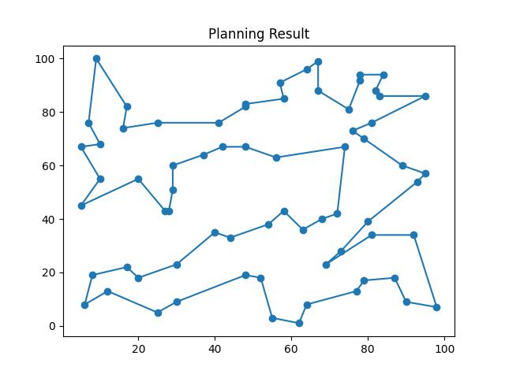
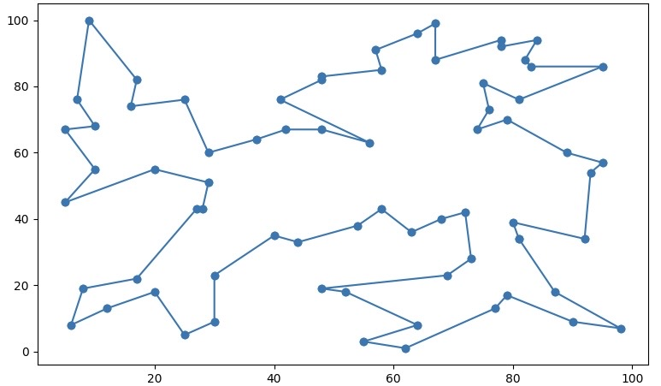
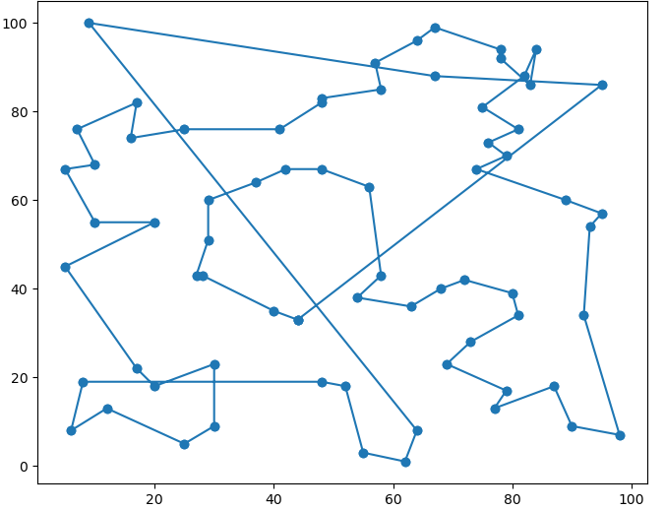
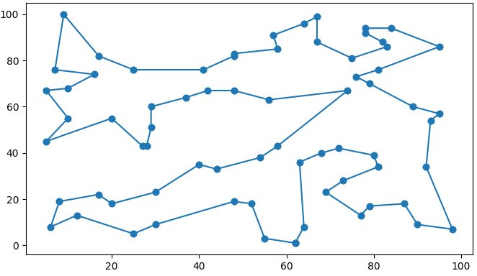
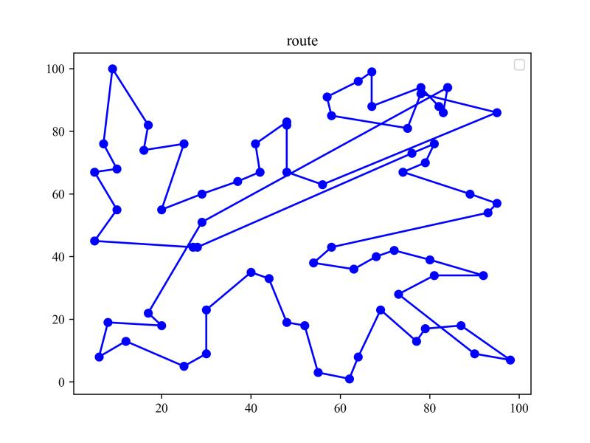
Results Analysis
GA
DP
ACO
SA
PN
Methods | Ant Colony Optimization (ACO) | Genetic Algorithm (GA) | Simulated Annealing (SA) | Dynamic Programming (DP) | Pointer Network (PN)
Path Length | 726 | 711 | 714 | 707 | 904
Notes:
This page shows the results of our experiments. Initially, it can be noticed that there are several crossings and loops on the roadmaps of ACO and PN, and the path lengths generated by ACO and PN are larger than the other path lengths, where PN generates the longest path length. It's probably because ACO is a probabilistic technique that can sometimes get trapped in suboptimal paths, and PN needs more training data and training time to get better results.
Additionally, focusing on the results of GA, SA and DP we can see that their path lengths are very close to each other, all significantly better than ACO and PN. There are a few apparent detours in their roadmaps that might be the result of these algorithms escaping local minima. Among the above algorithms, DP generates the shortest path length. The success of DP here might indicate that the problem size of 70 cities was within the feasible range for the algorithm to compute an exact solution efficiently.

Slide 34
Conclusion
Heuristic Algorithm
Exact Algorithm
Deep Neural Network
efficient for large problem instances
simple to implement and understand
guarantee to find the optimal solution
perform consistently
earn complex patterns and relationships within the data
quickly generate solutions for new instances
do not guarantee an optimal solution
performance and effectiveness can be inconsistent
require significant computational resources
require a large amount of training data
difficult to understand
⬇
⬇
⬇
invaluable for smaller instances where an optimal solution is paramount
a cutting-edge approach with the potential to revolutionize solutions
suitable for large or real-time applications
Notes:
Then I’d like to summarize the pros and cons of the three types of algorithms and the characteristics of their applications。
The first one is the Heuristic Algorithm. These algorithms are efficient for large problem instances and simple to implement, but they do not guarantee an optimal solution. They offer a practical trade-off between solution quality and computational efficiency, making them suitable for large or real-time applications.
Then we learn about the Exact Algorithm. These algorithms guarantee to find the optimal solution but require significant computational resources even for moderately sized problems. Hence they are invaluable for smaller instances where an optimal solution is paramount.
Finally, it comes to the deep neural network. DNNs can learn complex patterns and relationships within the data but require a large amount of training data to effectively learn and generalize.
All in all, the field of TSP problem is pushing the limit of deep learning. Although nowadays traditional solvers provide better solutions than learning models, further developments can still be considered. An attractive research direction is to leverage learning techniques to improve traditional solvers. For example, deep neural networks can be used to imitate expert heuristics and speed-up the computational time. Future work may focus on going beyond that, and there is a lot of potential for cutting-edge approaches to revolutionize how we solve TSP and other optimization problems.

Slide 35
References
[1] Dorigo, M., & Gambardella, L. M. (1997). Ant colony system: A cooperative learning approach to the traveling salesman problem. IEEE Transactions on Evolutionary Computation, 1(1), 53-66.
[2] Mirjalili, S., & Mirjalili, S. (2019). Genetic algorithm. Evolutionary algorithms and neural networks: Theory and applications, 43-55.
[3] Zhang, Yuan & Yuan, Yu & Lu, Kejing. (2019). E-commerce information system data analytics by advanced ACO for asymmetric capacitated vehicle delivery routing. Information Systems and e-Business Management. 18. 10.1007/s10257-019-00405-y.
[4] GfG. (2023, October 3). Nth Fibonacci number. GeeksforGeeks. https://www.geeksforgeeks.org/program-for-nth-fibonacci-number/
[5] G.H, Amaal & Ahmed, Tariq. (2008). Enhanced Bees Algorithms. 10.13140/RG.2.2.12666.95687.
[6] Konda V, Tsitsiklis J. Actor-critic algorithms[J]. Advances in neural information processing systems, 1999, 12.
[7] Peters J, Schaal S. Natural actor-critic[J]. Neurocomputing, 2008, 71(7-9): 1180-1190.
[8] Bello I, Pham H, Le Q V, et al. Neural combinatorial optimization with reinforcement learning[J]. arXiv preprint arXiv:1611.09940, 2016.
[9] Vinyals O, Fortunato M, Jaitly N. Pointer networks[J]. Advances in neural information processing systems, 2015, 28.
[10] Liu, S., Zhang, Y., Tang, K., & Yao, X. (2023). How good is neural combinatorial optimization? A systematic evaluation on the traveling salesman problem. IEEE Computational Intelligence Magazine, 18(3), 14-28.
[11] Bresson, X., & Laurent, T. (2021). The transformer network for the traveling salesman problem. arXiv preprint arXiv:2103.03012.
Notes:
These are our references and that’s all of our presentation.

Slide 36
Thank You
谢谢聆听
Group Members:
Fu Rao, Lin Xiaotao, Su Qianhui,
Yao Yang, Zhang Ruijie, Zhu Xinling
Notes:
Thank you.

